Slide 1
Analyzing H1b visa data using Hadoop Ecosystem
Presented by:
Name: Vishal Duratkar
Student ID: S171107500150
Center: Pune Deccan

Slide 2
Objective
To analyse various factors related to visas like Applicant, Employers, number of application, popular jobs etc…

Slide 3
Analyzing Factors
We will be evaluating below factors on the H1B visa applicants between the years 2011-2016.
1 a) Is the number of petitions with Data Engineer job title increasing over time?
b) Find top 5 job titles who are having highest growth in applications.
2 a) Which part of the US has the most Data Engineer jobs for each year?
b) find top 5 locations in the US who have got certified visa for each year.
3) Which industry has the most number of Data Scientist positions?
4) Which top 5 employers file the most petitions each year?
5) Find the most popular top 10 job positions for H1B visa applications for each year?
6) Find the percentage and the count of each case status on total applications for each year. Create a graph depicting the pattern of All the cases over the period of time.
7) Create a bar graph to depict the number of applications for each year.
8) Find the average Prevailing Wage for each Job for each Year (take part time and full time separate). Arrange the output in descending order.
9) Which are the employers along with the number of petitions who have the success rate more than 70% in petitions. (total petitions filed more than 1000) ?
10) Which are the job positions along with the number of petitions which have the success rate more than 70% in petitions (total petitions filed more than 1000)?
11) Export result for question no 10 to MySql database.

Slide 4
Technology used
Map Reduce :
A programming model and an associated implementation for processing and generating big data sets with a parallel, distributed algorithm on a cluster. It contains two important tasks, namely Map and Reduce. Map takes a set of data and converts it into another set of data, where individual elements are broken down into tuples (key/value pairs). Secondly, reduce task, which takes the output from a map as an input and combines those data tuples into a smaller set of tuples.
Hive :
An open-source data warehouse system for querying and analyzing large datasets stored in Hadoop files. It supports queries expressed in a language called HiveQL, which automatically translates SQL-like queries into MapReduce jobs executed on Hadoop.
Pig :
A platform for manipulating data stored in HDFS and that includes a compiler for map reduce programs and high level language called Pig Latin.it provides a way to perform data extractions, transformation and loading and basic analysis without having to write Map Reduce programs.
Sqoop :
A tool designed to transfer data between Hadoop and relational database servers. It is used to import data from relational databases such as MySQL, Oracle to Hadoop HDFS, and export from Hadoop file system to relational databases.

Slide 5
Big Data
Big data is a term for data sets that are so large or complex that traditional data processing application software is inadequate to deal with them.
The amount of data that’s being created and stored on a global level is almost inconceivable, and it just keeps growing.
This data can be analyzed for insights that lead to better decisions and strategic business moves.
It can be structured(Relational), semi structured(XML,JSON) and unstructured data(Word, PDF, Text and media logs ).
Challenges include capture, storage, analysis, search, sharing, transfer, visualization, querying. When “Big Data” emerged as a problem, Apache Hadoop evolved as a solution to it.

Slide 6
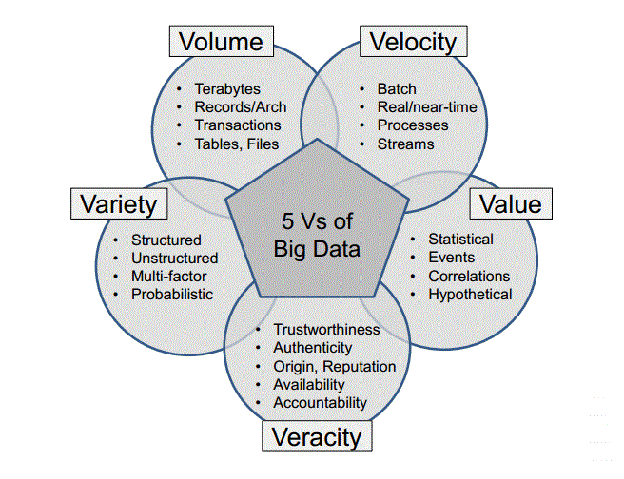
5 V’s of Big Data

Slide 7
Advantages of Big Data
Ability to store and process huge amounts of any kind of data, quickly. With data volumes and varieties constantly increasing, especially from social media and the Internet of Things (IoT), that's a key consideration.
Computing power. Hadoop's distributed computing model processes big data fast. The more computing nodes you use, the more processing power you have.
Fault tolerance. Data and application processing are protected against hardware failure. If a node goes down, jobs are automatically redirected to other nodes to make sure the distributed computing does not fail. Multiple copies of all data are stored automatically.
Flexibility. Unlike traditional relational databases, you don’t have to pre-process data before storing it. You can store as much data as you want and decide how to use it later. That includes unstructured data like text, images and videos.
Low cost. The open-source framework is free and uses commodity hardware to store large quantities of data.
Scalability. You can easily grow your system to handle more data simply by adding nodes. Little administration is required.

Slide 8
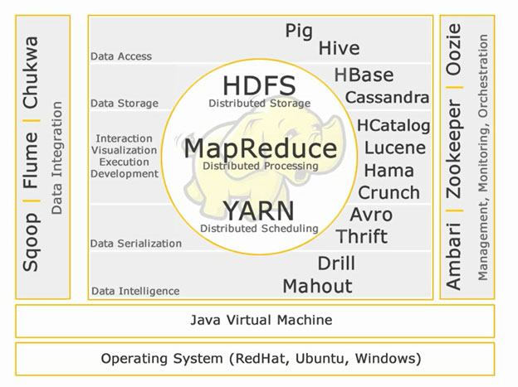
Hadoop Ecosystem

Slide 9
HDFS
Hadoop File System was developed using distributed file system design. It is run on commodity hardware.
Unlike other distributed systems, HDFS is highly fault tolerant and designed using low-cost hardware.
HDFS holds very large amount of data and provides easier access.
To store such huge data, the files are stored across multiple machines. These files are stored in redundant fashion to rescue the system from possible data losses in case of failure.
HDFS also makes applications available to parallel processing.

Slide 10
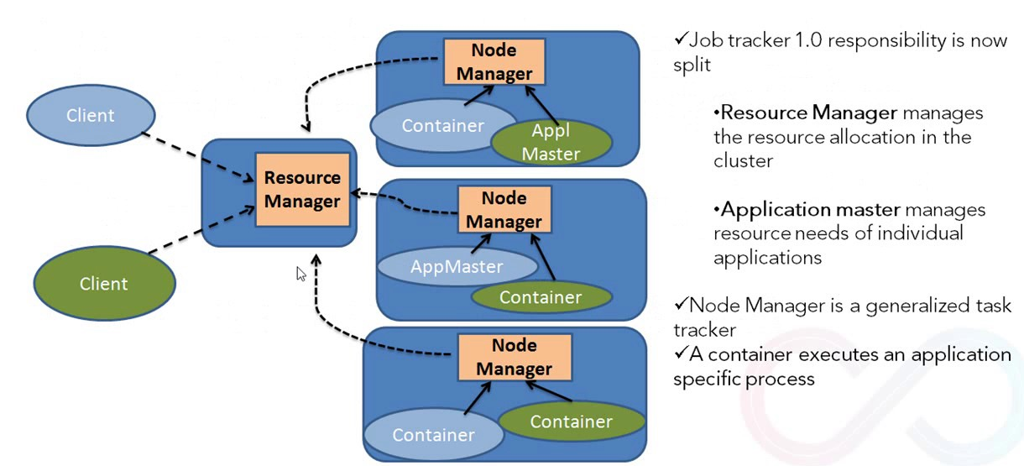
YARN
The fundamental idea of YARN is to split up the functionalities of resource management and job scheduling/monitoring into separate daemons. The idea is to have a global ResourceManager (RM) and per-application ApplicationMaster (AM). An application is either a single job or a DAG of jobs.

Slide 11
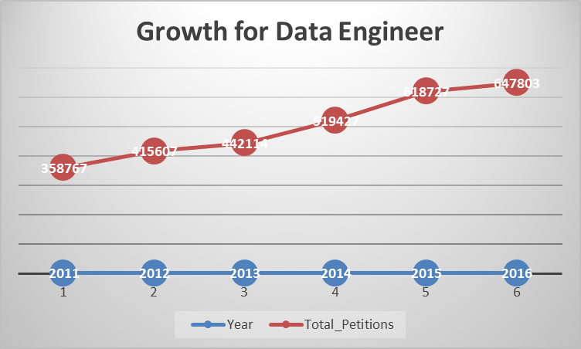
Analysing H1B Visa Using Hadoop Ecosystem
Analysis 1:
a) Is the number of petitions with Data Engineer job title increasing over time?
Technology used : Map Reduce

Slide 12
Analysing H1B Visa Using Hadoop Ecosystem
Analysis 1
b) Find top 5 job titles who are having highest growth in applications.
Technology used: Map Reduce
Sample output:
SENIOR SYSTEMS ANALYST JC60 Cycle Growth -> ( 21150.0,-7.0,31.0,17.0,86.0) Average Growth -> 4255.4
SYSTEMS ANALYST JC65 Cycle Growth -> ( 14850.0,-7.0,23.0,-22.0,81.0) Average Growth -> 2985.0
MODULE LEAD Cycle Growth -> ( 14566.0,-96.0,98.0,51.0,-33.0)Average Growth -> 2917.2
SYSTEMS ANALYST - III Cycle Growth -> ( 0.0,14200.0,62.0,56.0,-27.0) Average Growth -> 2858.2
PROGRAMMER/DEVELOPER Cycle Growth -> ( -71.0,300.0,25.0,60.0,9381.0) Average Growth -> 1939.0

Slide 13
Analysing H1B Visa Using Hadoop Ecosystem
Analysis 2:
a) Which part of the US has the most Data Engineer jobs for each year?
Technology used: MapReduce
Sample Output:
2011 WASHINGTON 20 2014 CALIFORNIA 129 2011 CALIFORNIA 13 2014 WASHINGTON 45 2011 NEW YORK 5 2014 NEW YORK 20
2012 WASHINGTON 32 2015 CALIFORNIA 197 2012 CALIFORNIA 22 2015 WASHINGTON 66 2012 MASSACHUSETTS 5 2015 NEW YORK 49
2013 CALIFORNIA 56 2016 CALIFORNIA 328 2013 WASHINGTON 47 2016 WASHINGTON 140 2013 GEORGIA 9 2016 NEW YORK 82

Slide 14
Analysing H1B Visa Using Hadoop Ecosystem
Analysis 2:
b) find top 5 locations in the US who have got certified visa for each year.
Technology used: Hive
Sample Output:
2011 CALIFORNIA 56252 2014 CALIFORNIA 85164 2011 NEW YORK 35244 2014 TEXAS 45091
2012 CALIFORNIA 64537 2015 CALIFORNIA 100710 2012 NEW YORK 37086 2015 TEXAS 55066
2013 CALIFORNIA 72171 2016 CALIFORNIA 104070 2013 NEW YORK 36460 2016 TEXAS 59694

Slide 15
Analysing H1B Visa Using Hadoop Ecosystem
Analysis 3:
Which industry(SOC_NAME) has the most number of Data Scientist positions?
Technology used: Pig
Sample Output:
STATISTICIANS 564 COMPUTER AND INFORMATION RESEARCH SCIENTISTS 466 OPERATIONS RESEARCH ANALYSTS 350 Computer and Information Research Scientists 205 COMPUTER OCCUPATIONS, ALL OTHER 158 Statisticians 135 MATHEMATICIANS 131 SOFTWARE DEVELOPERS, APPLICATIONS 127 COMPUTER SYSTEMS ANALYSTS 111 Operations Research Analysts 102

Slide 16
Analysing H1B Visa Using Hadoop Ecosystem
Analysis 4:
Which top 5 employers file the most petitions each year? - Case Status - ALL
Technology used: Hive
Sample Output:
2011 TATA CONSULTANCY SERVICES LIMITED 5416 2011 MICROSOFT CORPORATION 4253
2012 INFOSYS LIMITED 15818 2012 WIPRO LIMITED 7182
2013 INFOSYS LIMITED 32223 2013 TATA CONSULTANCY SERVICES LIMITED 8790
2014 INFOSYS LIMITED 23759 2014 TATA CONSULTANCY SERVICES LIMITED 14098
2015 INFOSYS LIMITED 33245 2015 TATA CONSULTANCY SERVICES LIMITED 16553
2016 INFOSYS LIMITED 25352 2016 CAPGEMINI AMERICA INC 16725 2016 TATA CONSULTANCY SERVICES LIMITED 13134

Slide 17
Analysing H1B Visa Using Hadoop Ecosystem
Analysis 5:
a) Find the most popular top 10 job positions for H1B visa applications for each year? for all the applications
Technology used: Hive
Sample Output:
2011 PROGRAMMER ANALYST 31799 2011 SOFTWARE ENGINEER 12763
2012 PROGRAMMER ANALYST 33066 2012 SOFTWARE ENGINEER 14437
2013 PROGRAMMER ANALYST 33880 2013 SOFTWARE ENGINEER 15680
2014 PROGRAMMER ANALYST 43114 2014 SOFTWARE ENGINEER 20500
2015 PROGRAMMER ANALYST 53436 2015 SOFTWARE ENGINEER 27259
2016 PROGRAMMER ANALYST 53743 2016 SOFTWARE ENGINEER 30668

Slide 18
Analysing H1B Visa Using Hadoop Ecosystem
Analysis 5:
b) Find the most popular top 10 job positions for H1B visa applications for each year? for only certified applications.
Technology used: Hive
Sample Output:
2011 PROGRAMMER ANALYST 28806 2011 SOFTWARE ENGINEER 11224
2012 PROGRAMMER ANALYST 29226 2012 SOFTWARE ENGINEER 12273
2013 PROGRAMMER ANALYST 29906 2013 SOFTWARE ENGINEER 12973
2014 PROGRAMMER ANALYST 38625 2014 SOFTWARE ENGINEER 17278
2015 PROGRAMMER ANALYST 48203 2015 SOFTWARE ENGINEER 23352
2016 PROGRAMMER ANALYST 47964 2016 SOFTWARE ENGINEER 25890

Slide 19
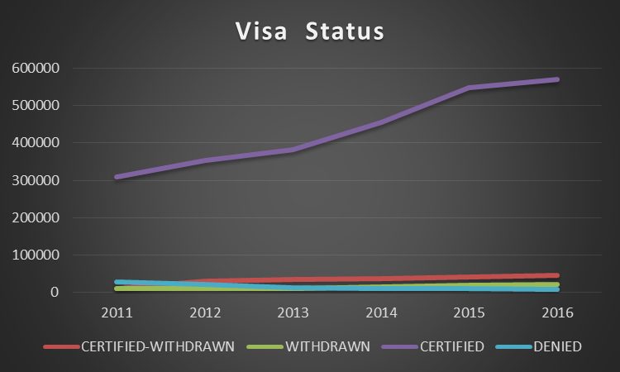
Analysing H1B Visa Using Hadoop Ecosystem
Analysis 6:
Find the percentage and the count of each case status on total applications for each year. Create a line graph depicting the pattern of All the cases over the period of time
Technology used: Pig

Slide 20
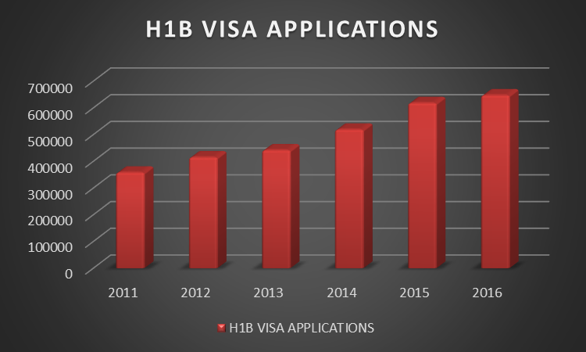
Analysing H1B Visa Using Hadoop Ecosystem
Analysis 7:
Create a bar graph to depict the number of applications for each year
Technology used: Pig

Slide 21
Analysing H1B Visa Using Hadoop Ecosystem
Analysis 8:
Find the average Prevailing Wage for each Job for each Year (take part time and full time separate). Arrange the output in descending order.
Technology used: Pig
Sample Output:
2011 Full Time
ASSOCIATE SQA ENGINEER 9853122.909090908 TEACHER (MATHEMATICS) 9491354.0 SENIOR AUDIT ASSOCIATE 9422870.636363637 ELEMENTARY SCHOOL SPANISH TEACHER 9078950.0
2011 Part Time
INSTRUCTOR OF COMPUTER SCIENCE 189820.0 HEAD, GLOBAL FINANCIAL SECTOR PRACTICE 189779.0 SENIOR VICE PRESIDENT, SURVEY RESEARCH 189779.0 DIRECTOR OF BRAND PARTNERSHIPS 189280.0

Slide 22
Analysing H1B Visa Using Hadoop Ecosystem
Analysis 9:
Which are the employers along with the number of petitions who have the success rate more than 70% in petitions. (total petitions filed more than 1000) ?
Technology used: MapReduce
Sample Output:
INFOSYS LIMITED 99.54
DIASPARK, INC. 99.51
ACCENTURE LLP 99.39
TECH MAHINDRA (AMERICAS),INC. 99.34
TATA CONSULTANCY SERVICES LIMITED 99.34
YASH TECHNOLOGIES, INC. 99.28
YASH & LUJAN CONSULTING, INC. 99.27
HCL AMERICA, INC. 99.27
RELIABLE SOFTWARE RESOURCES, INC. 99.15
NTT DATA, INC. 99.13

Slide 23
Analysing H1B Visa Using Hadoop Ecosystem
Analysis 10:
Which are the job positions along with the number of petitions which have the success rate more than 70% in petitions (total petitions filed more than 1000)?
Technology used: MapReduce
Sample Output:
ASSOCIATE CONSULTANT - US 99.93
SYSTEMS ENGINEER - US 99.90
TEST ENGINEER - US 99.86
PRODUCTION SUPPORT ANALYST - US 99.86
TEST ANALYST - US 99.82
CONSULTANT - US 99.81
TECHNOLOGY LEAD - US 99.80
TECHNICAL TEST LEAD - US 99.80
SENIOR TECHNOLOGY ARCHITECT - US 99.79

Slide 24
Analysing H1B Visa Using Hadoop Ecosystem
Analysis 11:
Export result for question no 10 to MySql database.
Technology used: MapReduce
Sample Code:
sqoop export --connect jdbc:mysql://localhost/project --username root
--password 'vishal' --table problem10data
--update-mode allowinsert --update-key job_title
--export-dir /project/project10/part-r-00000
--input-fields-terminated-by '\t';

Slide 25
Conclusion
From my analysis I have found that Infosys and TCS are the top most companies who are granting more visas, and the number of the petitioners are increasing in each year.

Slide 26
Analysing H1B Visa Using Hadoop Ecosystem
THANK YOU…

